Slide 1
Resolution Writing
11 October 2017

Slide 2
Who?
Any delegate in the committee can write a resolution. The author of a resolution is called a sponsor. Most resolutions have multiple sponsors because it takes a group of countries to share good ideas and to come to a consensus. Some conferences allow delegates to sponsor multiple resolutions for each topic while others only allow delegates to sponsor one per topic

Slide 3
When/where?
Resolutions are usually written during unmoderated caucus where delegates are free to roam around the committee to collaborate on ideas with each other, and sometimes students work outside in hallways or computer labs as well. Resolution-writing becomes more focused during the latter sessions of committee when different country policies are clear and different ideas have been mentioned already. These conferences will not allow any pre-written resolutions.

Slide 4
Why?
The ultimate purpose of a committee session is to pass a resolution. All the speeches, debate, negotiation, and teamwork is supposed to lead up to a resolution which contains all the proposed solutions to the issue. The resolution(s) that the majority of the committee agrees upon will be passed during voting bloc and the sponsors will be informally commended for building consensus on good ideas. Most conferences allow multiple resolutions to pass as long as they do not contradict each other, but a few conferences allow only one resolution to pass.

Slide 5
Heading
Top right corner is a made up name (color, place. etc)
Chair will tell you what the minimum for sponsors and signatories
Topic is the one from the conference
You will know which committee you are in

Slide 6
Preambuatory Clauses
Separated by commas and ended by semicolon
Copy and paste them!

Slide 7
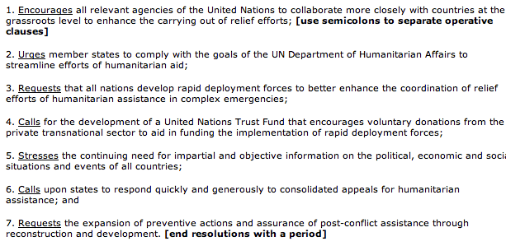
Operative Clauses

Slide 8
Operative Clauses
Actions to be taken
Specific actions with detail
Think of who, what, when, where, why, and funding
Separated by number, uppercase letter, lowercase roman numeral, and then lowercase letter
All in commas and the last one ends in a period

Slide 9
Operative Clauses
Example
Example
Example
Example
Example
Example
Example
Example
Example

